Slide 1
Open Spanish Restaurant in Barcelona, Spain
IBM- Elza Miquel

Slide 2
1- Introduction
1- I want to start a new Spanish Restaurant in Barcelona, Spain.
2- However, where location I put it because it will be profitable?
3- Which Neighbourshood are better for my objective question?

Slide 3
2- Problems to start a new Spanish Restaurant in Barcelona, Spain
1- Barcelona is important turistic city in Spain. There are too many restaurants and pubs.
2- Cusine culture is topic in Barcelona. There are more than 7400 restaurants and bars.
3- Turism'll eat in their hotels probably.

Slide 4
3 – Target public.
1- Turism wants to taste tipic catalan and spanich food with since smart vision.
2- Age people between 30-50 years who love food experience and to discover news and locals products.
3- This target may be local people who want same experience a good price.
4- My clients are interesting in food ecological products, natural tractaments and smart calid descoration.

Slide 5
4– Data origins
From geopy which convert an address into latitude and longitude values.
From FourSquare API
From Wikipedia: https://en.wikipedia.org/wiki/Category:Neighbourhoods_of_Barcelona

Slide 6


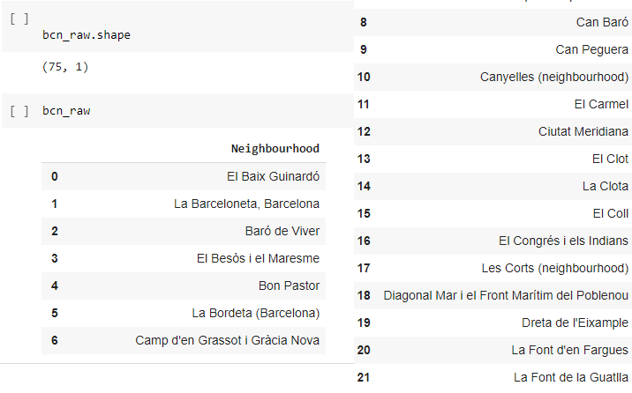

5- Resolve it
1- There are 75 Neighbourhood:

Slide 7
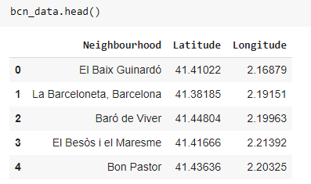
2- With GEOCODER:

Slide 8
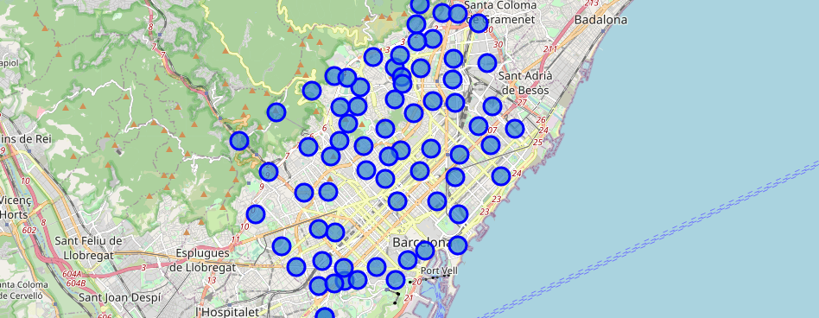
z
3- Let's plot map of Barcelona using latitude and longitude values.

Slide 9
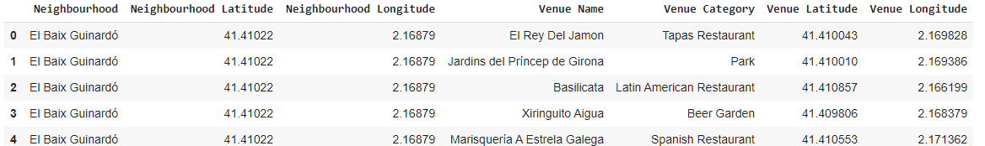
4- Create clusters with KMEANS:

Slide 10
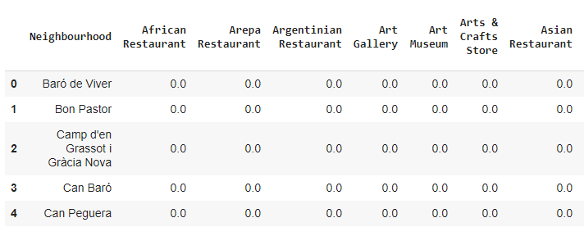
z
5- analyze neighbourhoods of Barcelona

Slide 11
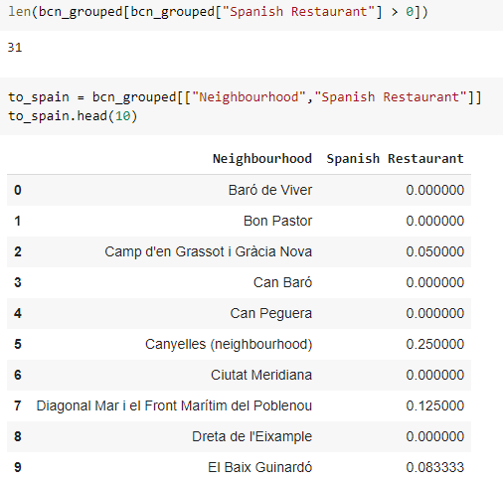
6- In Which neighbourhood there are Spanish Restaurants?

Slide 12
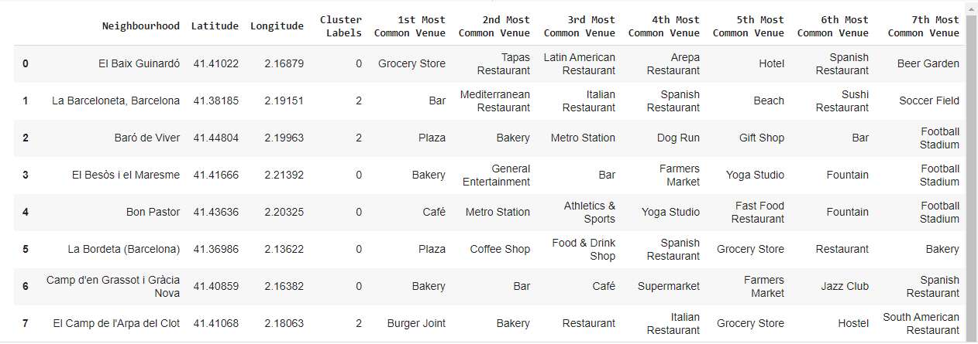

Slide 13
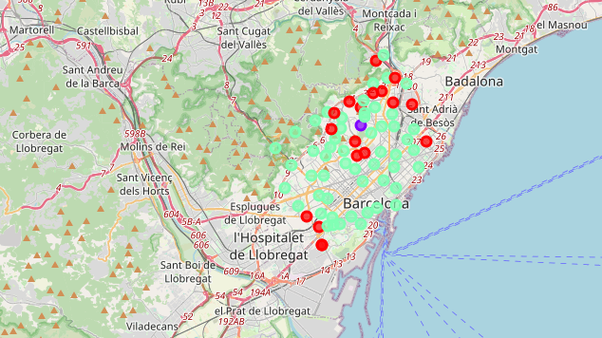

Slide 14
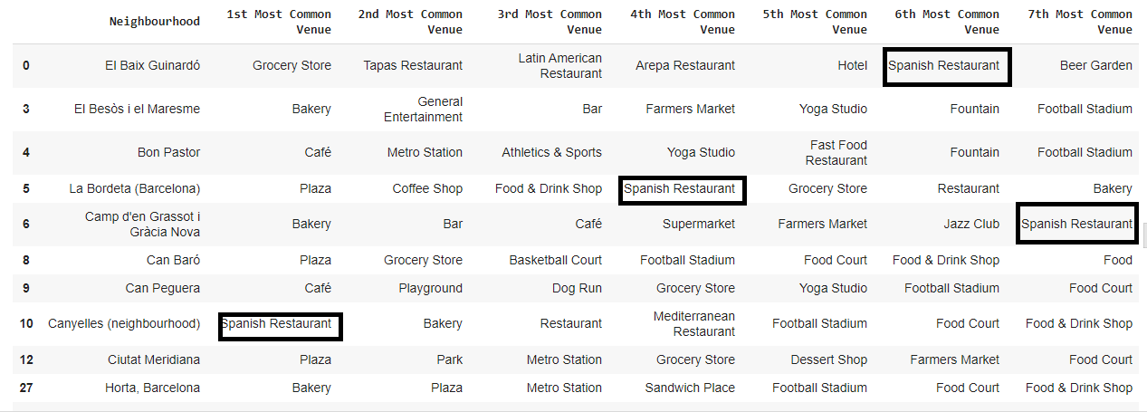

Slide 15
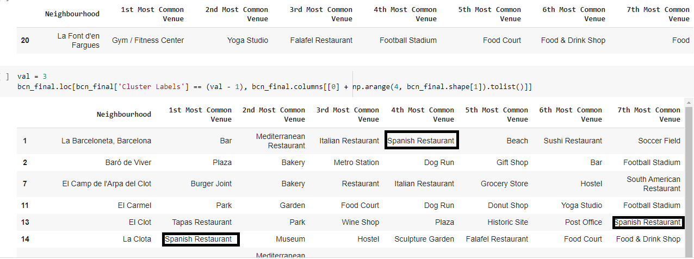

Slide 16
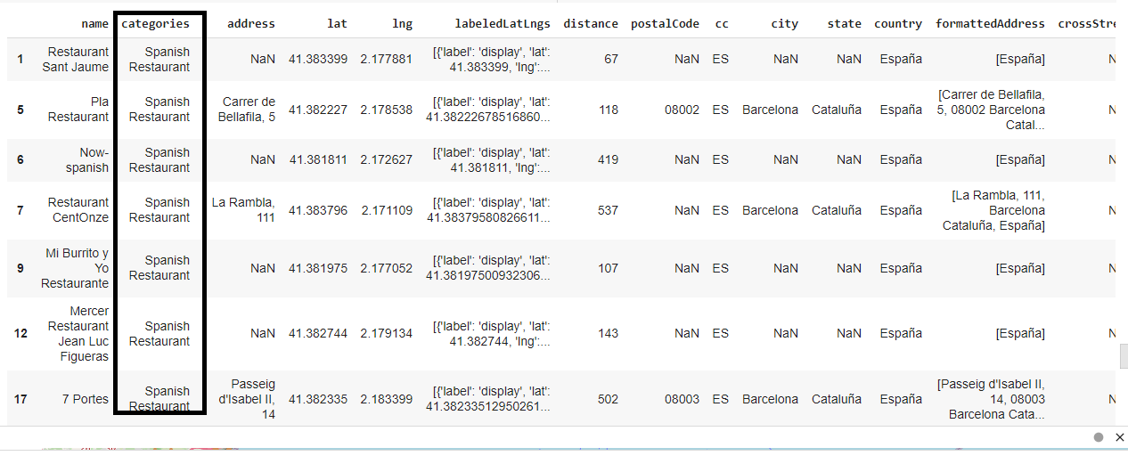

Slide 17
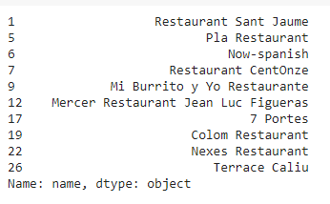
All Spanish Restaurant in radius 500 meters to Majestic Hotel
Haga clic para agregar texto

Slide 18
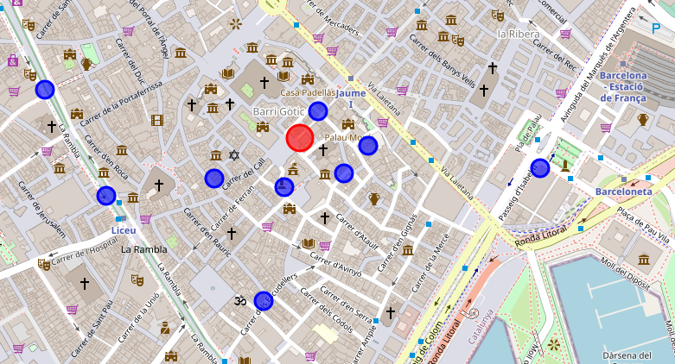

Slide 19
z
6. Conclusion
I see there are 8 Spanish Restaurants around Majestic Hotel location them, currently on Barri Gotic.
There are two good oportunities at Camp d'en Grassot i Gràcia Nova and at Vall d'Hebron and at Clot.

Slide 20
z
If I consider more items I can see first option is better than last other because, in there place there are few seafood and mediterranian restaurants but it's important item for their neighbours and transit turism is better than other option.

Slide 21

z
THANKS!!!

